Slide 1
Project 3
Tadeo Salinas
Juan Coronado
Mauricio Ruiz
José Rodríguez

Slide 2
Mexico Population Analysis
Based on INEGI 2020 database

Slide 3
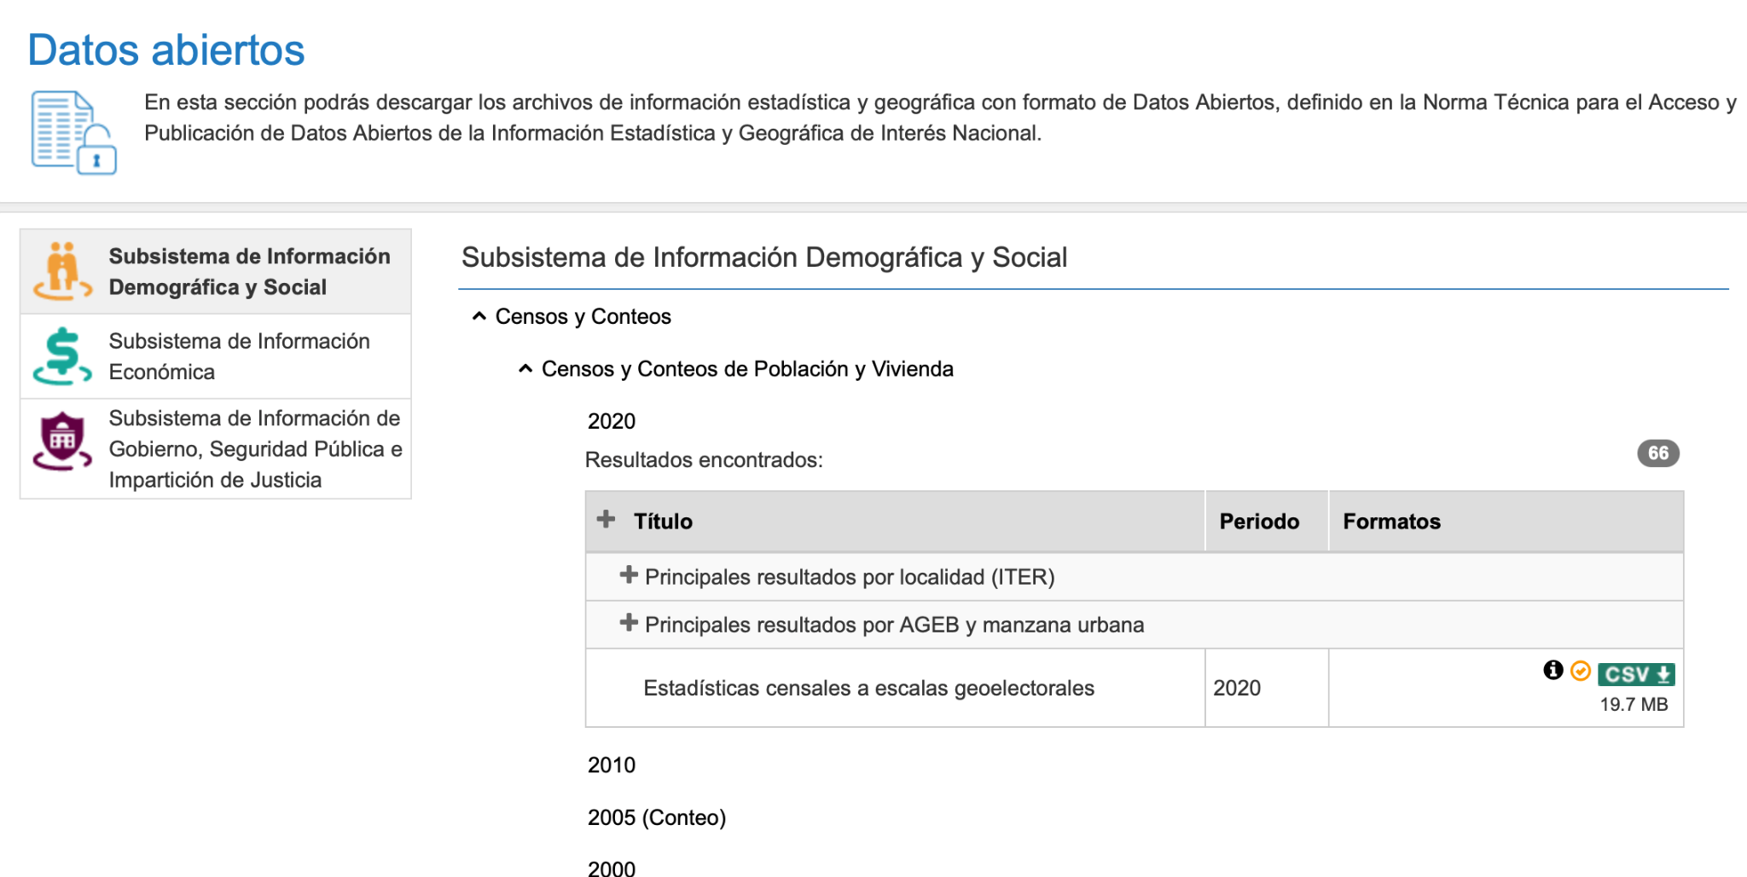
Main results by locality (ITER) of the 2020 Population and Housing Census. Timely data
https://www.inegi.org.mx/datosabiertos/
Los datos que se han descargado forman parte de la colección de archivos de estadística y geografía con formato de Datos Abiertos.
Route:
Demographic and Social Information Subsystem
Population and Housing Censuses and Counts
2020
Main results by location
Estados Unidos Mexicanos

Slide 4
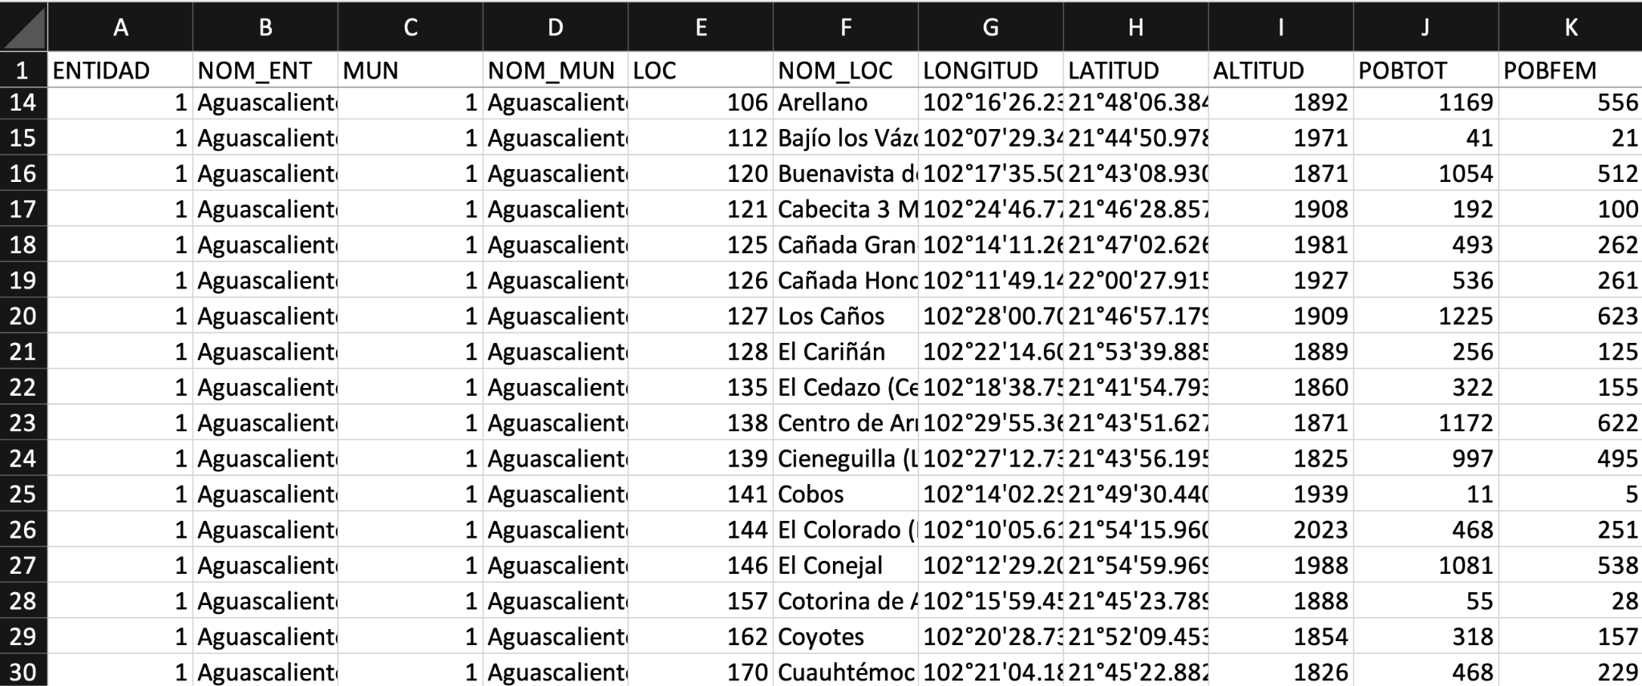
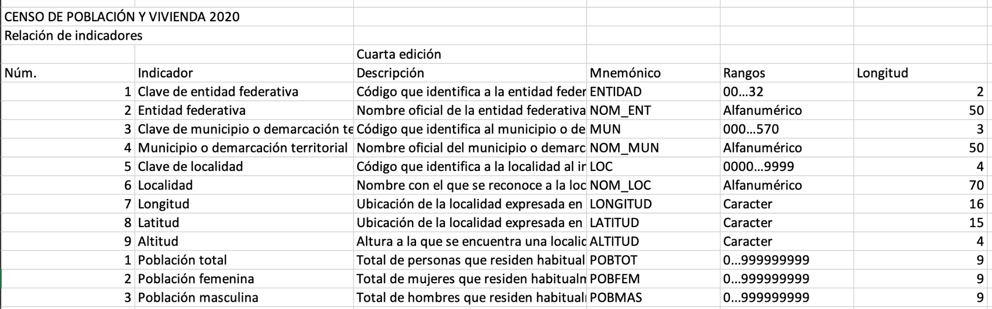
Main results by locality (ITER) of the 2020 Population and Housing Census. Timely data
https://www.inegi.org.mx/datosabiertos/
Content:
catalogue
data
data dictionary
metadata
We used the data folder for getting all of the raw data (before transforming using Jupyter Notebook).
Another helpful file was the data dictionary, since all columns are coded, and data dictionary clearly explains the keys and the values for the data.

Slide 5
Mexico Population Analysis
Based on INEGI 2020 database

Slide 6
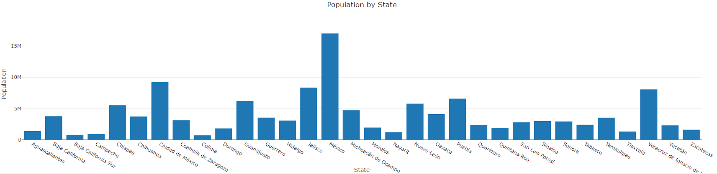
POPULATION PER STATE
The total people in Mexico was 126 million , the top 5 was :
Estado de México 16,992,418 13.5 %
Ciudad de México 9,209,944 7.3 %
Jalisco 8,348,151 6.6 %
Veracruz 8,062,579 6.4 %
Puebla 6,583,278 5.2 %
The 5 least populated states:
Tlaxcala 1,342,977 1.1 %
Nayarit 1,235,456 1.0 %
Campeche 928,363 0.7 %
Baja California Sur 798,447 0.6 %
Colima 731,391 0.6 %
Notes:
The percentage in the top five was 40%,
the percentage in the least five was 4%
The 3 most populates cities were Baja California , Iztalapa y Leon, 5% of the 100%,
49% Male and 51% Female
The range with the most population was the rane 10-4 8.7%

Slide 7
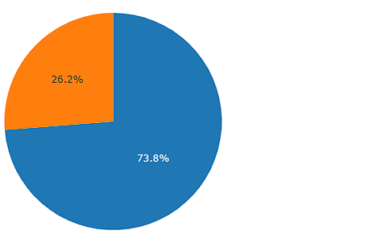

POPULATION WITHOUT ACCESS TO MEDICAL SERVICES
73.8% - Access to Healthcare
26.2% - No Access to Healthcare
While nearly three-fourths (73.8%) of Mexico's population has healthcare access, a significant 26.2% remains underserved with no access to vital medical services. Mexico must aim to close this gap and ensure healthcare for all.

Slide 8
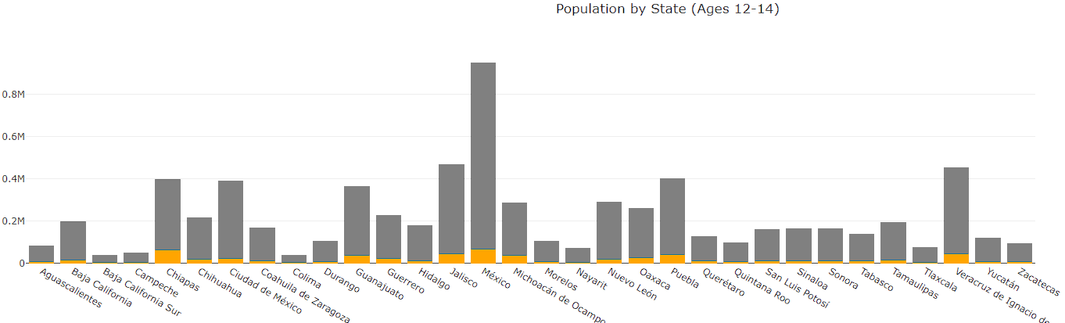

POPULATION WITH 12 TO 14 YEARS OLD
NOT ASSISTING TO SCHOOL
The top 3 states:
1st Chiapas at 18.4%
2nd Michoacan at 14.2%
3rd Guanajuato at 11.7%
The bottom 3 states:
1st Baja California Sur at 5.7%
2nd Hidalgo at 5.8%
3rd Ciudad de Mx at 6.5%

Slide 9
Code Used
Index.html
CSS
Logic.js
App.py
SQL
ipynb

Slide 10
SQL

Slide 11
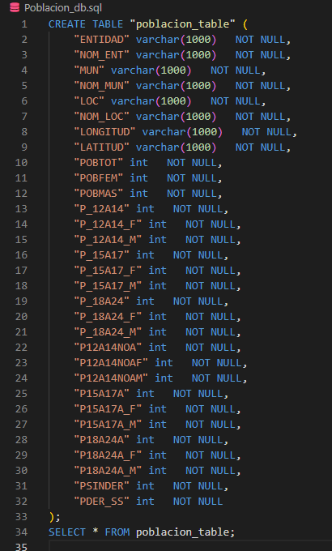
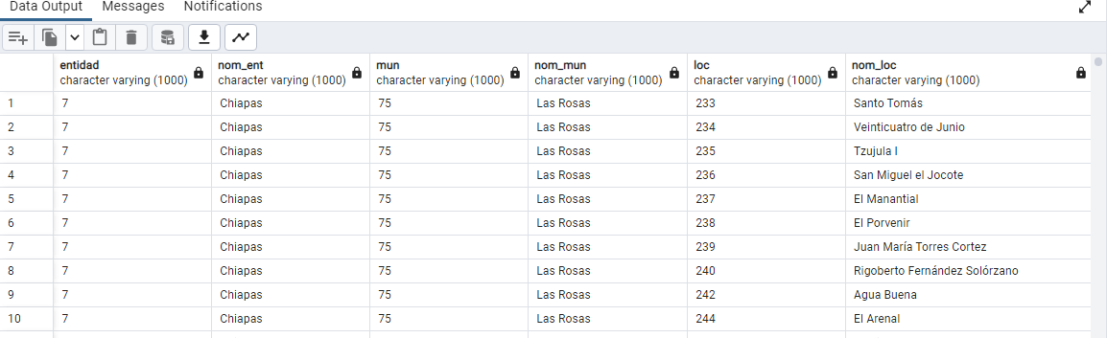
SQL / PGADMIN
The code defines a new table called "poblacion_table" with various columns, each representing different demographic data, such as population count by age group, gender, location, and more. The final SQL statement SELECT * FROM poblacion_table is used to query and display all the data stored in the newly created "poblacion_table".

Slide 12
ipynb

Slide 13
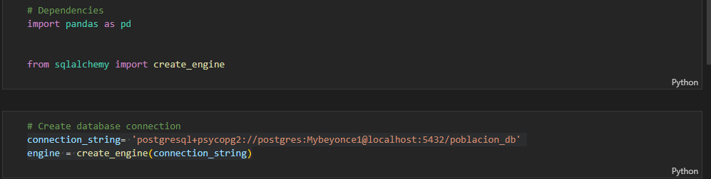
This part of the code import the library and connects to a PostgreSQL database

Slide 14
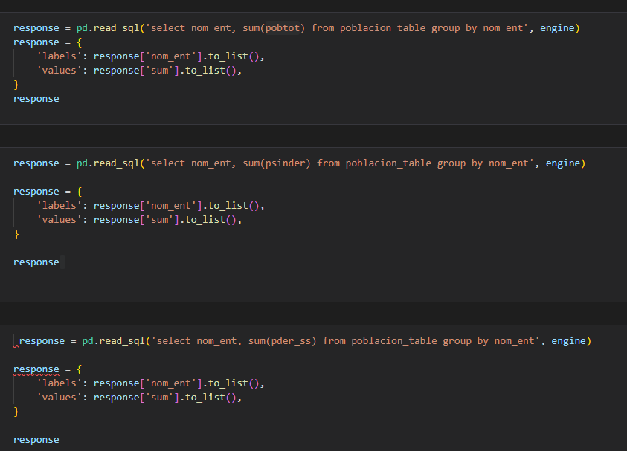
with this code we read data from a SQL database and we put into a dictionary

Slide 15
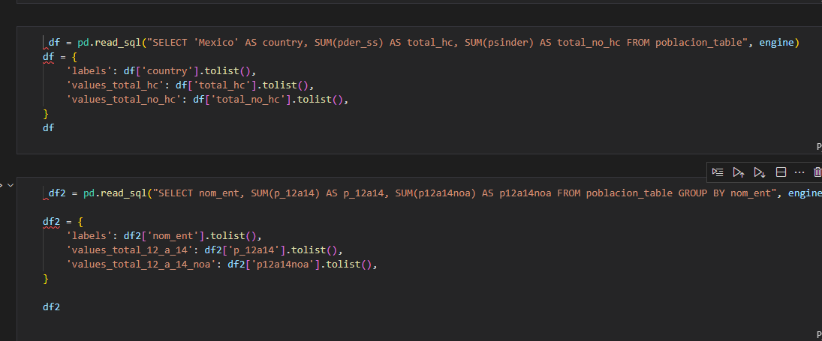

Slide 16
app.py

Slide 17
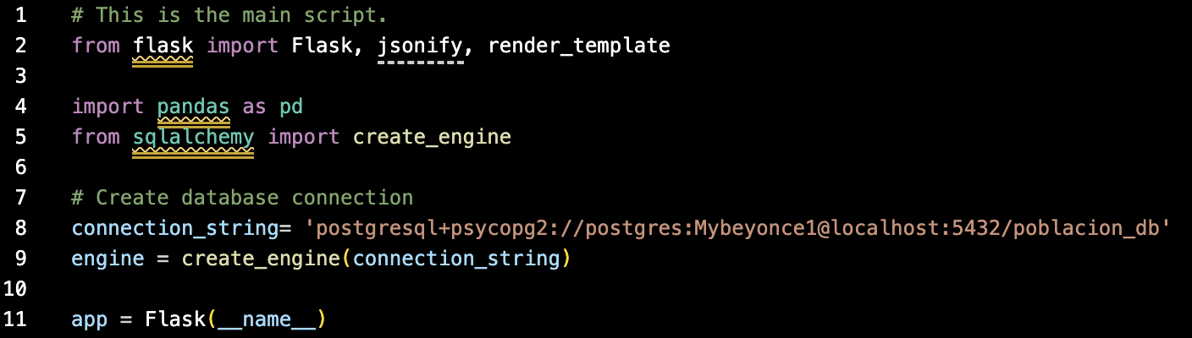
The provided code is a Flask web application that connects to a PostgreSQL database ('poblacion_db') to retrieve and present various demographic statistics related to the Mexican population. The data is accessed through SQL queries using the pandas library to manage and process the data efficiently.

Slide 18
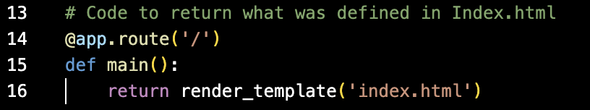
/api:
This endpoint fetches data to display the total population per state in Mexico.
The SQL query groups the data by state ('nom_ent') and calculates the sum of the total population ('pobtot').
The results are returned as a JSON object with 'labels' representing state names and 'values' containing the corresponding total population numbers.

Slide 19
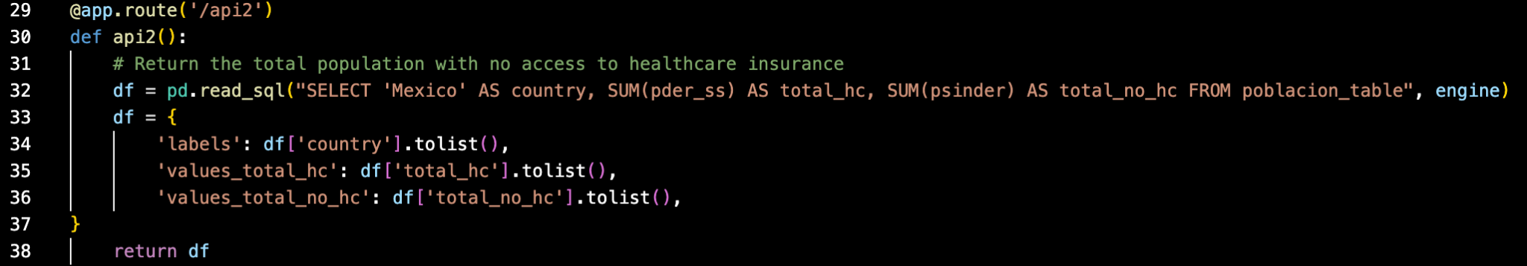
/api2:
This endpoint retrieves data to show the total population with and without access to healthcare insurance ('hc' and 'no_hc', respectively).
The SQL query calculates the sums of 'pder_ss' (population with healthcare insurance) and 'psinder' (population without healthcare insurance) across the entire country ('Mexico').
The results are returned as a JSON object with 'labels' representing the country name, 'values_total_hc' containing the population with healthcare insurance, and 'values_total_no_hc' containing the population without healthcare insurance.

Slide 20
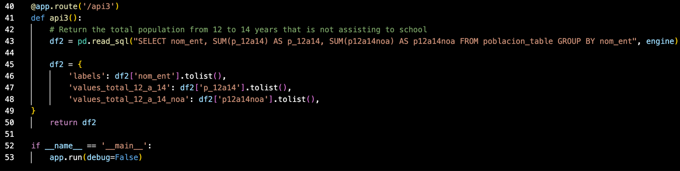
/api3:
This endpoint fetches data to illustrate the total population aged 12 to 14 years, differentiating between those attending school ('p_12a14') and those not attending school ('p12a14noa') for each state ('nom_ent').
The SQL query groups the data by state and calculates the sums of 'p_12a14' (population attending school) and 'p12a14noa' (population not attending school) in the specified age group.
The results are returned as a JSON object with 'labels' representing state names, 'values_total_12_a_14' containing the population attending school, and 'values_total_12_a_14_noa' containing the population not attending school.
Go Back

Slide 21
index.html

Slide 22
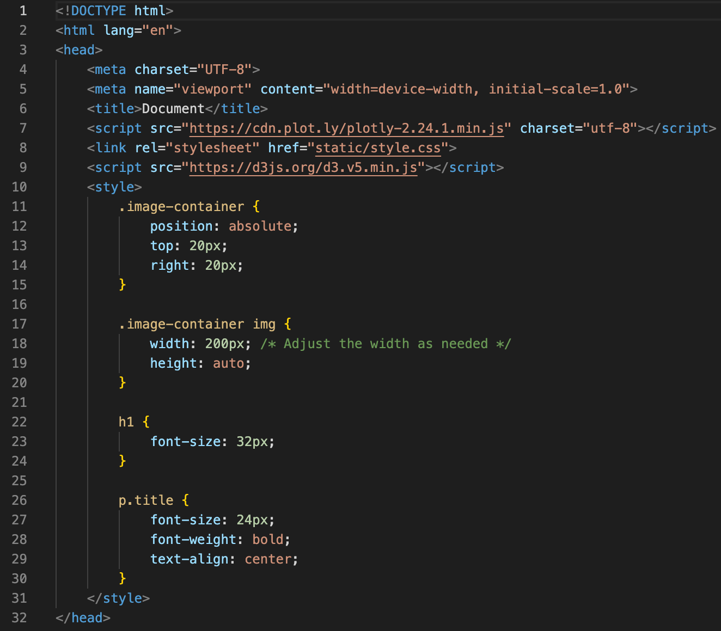
Index
This is the first part of the index file. What this code does is the following:
Code needed to use Plotly.
References the style.css file for customization.
Code needed to use d3.
The other lines are used to change various formatting options related to:
the images’ positions and width/height.
h1 and titles’ font size, weight, and align option.

Slide 23
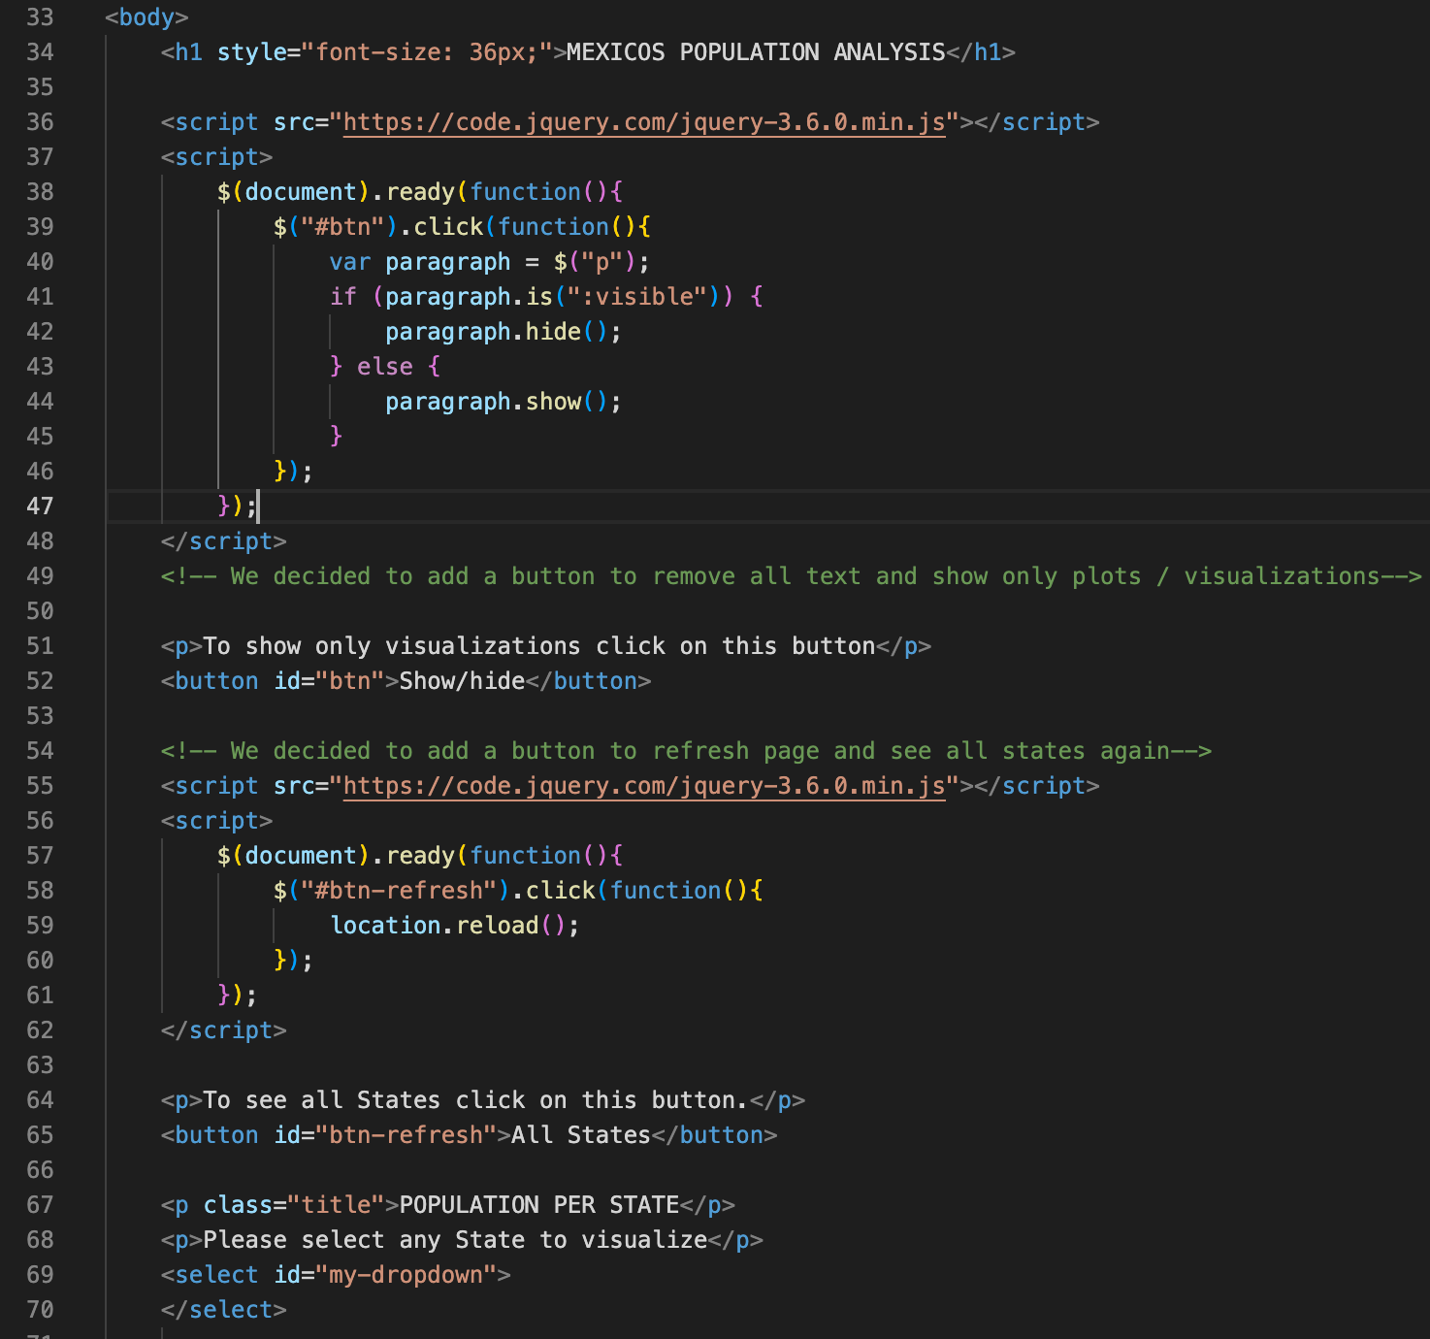
Index
This is the second part of the index file. What this code does is the following:
Code needed to use jQuery is loaded in this section.
One button will control if everything can be seen, or if all text disappears and only visualizations are left in the dashboard. This is controlled via a Show/hide button.
Another button controls if all States should be shown. A user is able to select different states to visualize the information. If he/she wishes to see all data again, they can do do here. This is controlled via a All States button.

Slide 24
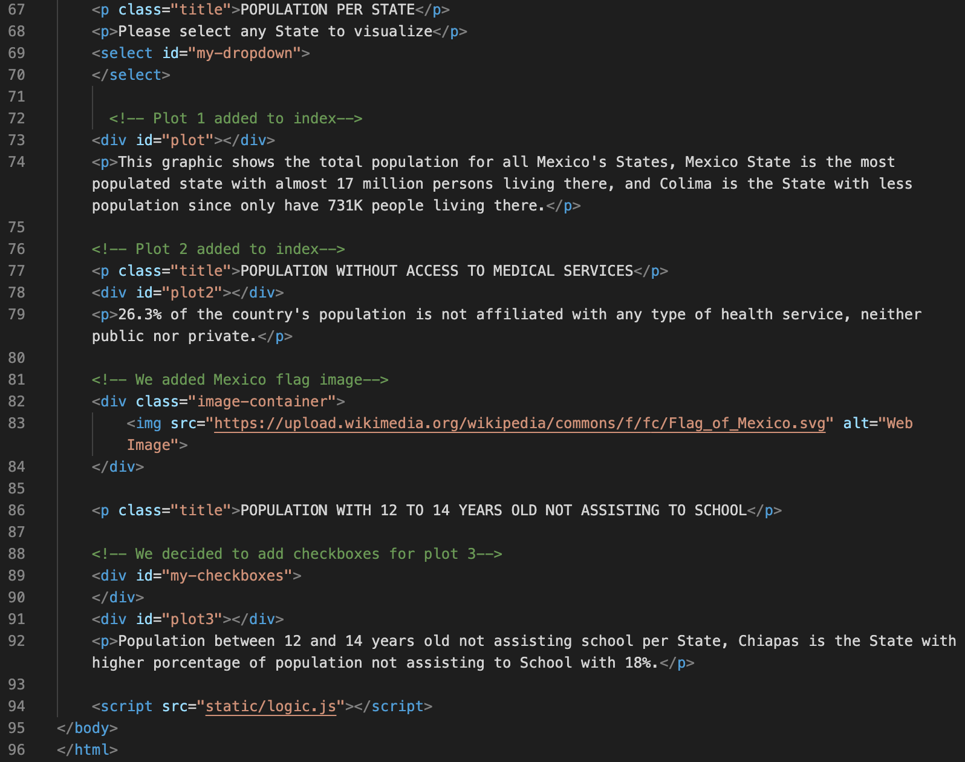
Index
This is the final part of the index file. Here, the charts and their functions’ code is written.
The 3 charts each use consecutive numbers, being their ids: plot, plot2, and plot3.
Common elements in the charts include the actual chart and a small descriptions of key insights. Some code that controls this is on previous sections.
1st chart: bar chart that gets filtered based on the state selected in the dropdown.
2nd chart: pie chart, no filters affect it.
3rd chart: bar chart that gets filtered based on the states selected from the multiple options menu.
Also, here we see that the file logic.js is being called.
Finally, a small mexican flag was added to the upper right corner, using a URL.

Slide 25
style.css

Slide 26
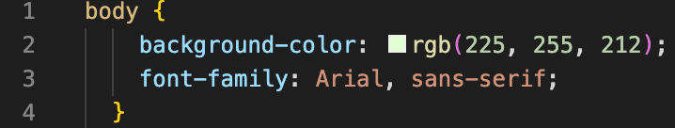
style.css
This is the only code being used in the style file.
It controls the background color of all the page and the type of font used throughout the page.

Slide 27


logic.js
JavaScript libraries used
D3
jQuery

Slide 28
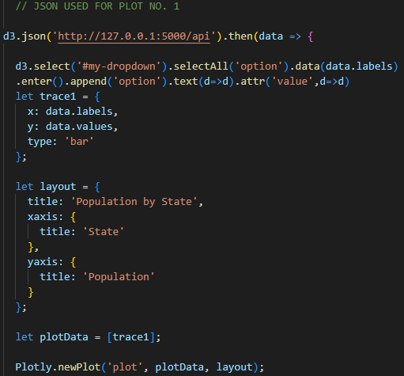
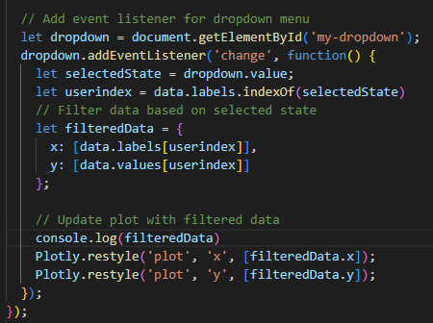
PLOT 1 - Total population per state
This JavaScript code uses D3.js and Plotly to create an interactive bar chart displaying population data for different states. It fetches the data from a local API endpoint and initializes the chart. The code generates a dropdown menu with state options. When a state is selected from the dropdown, the chart updates to display the population of the chosen state.

Slide 29
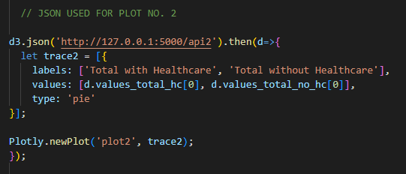
PLOT 2 - Population without access to medical services
This code fetches data from a local API endpoint, which likely contains information about healthcare statistics. It then uses the Plotly library to create a pie chart representing the proportion of the total population with and without healthcare. The chart has two segments: 'Total with Healthcare' and 'Total without Healthcare', and the sizes of these segments are based on the values obtained from the fetched data.

Slide 30
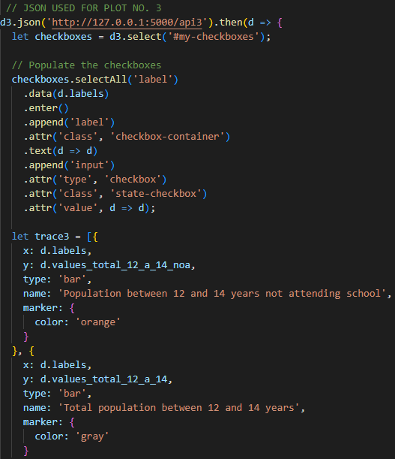
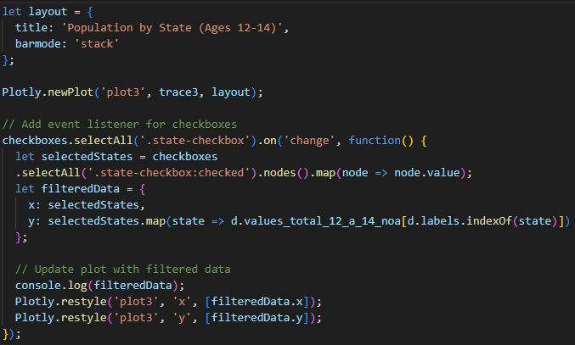
PLOT 3 - Population with 12 to 14 years old
not assisting to school
This code creates a bar chart representing the population between ages 12 and 14 not attending school and the total population in that age group for different states. Users can interactively select specific states through checkboxes, and the chart will update to show the data for the selected states.
Go Back

Slide 31
THANK YOU!

